Slide 1
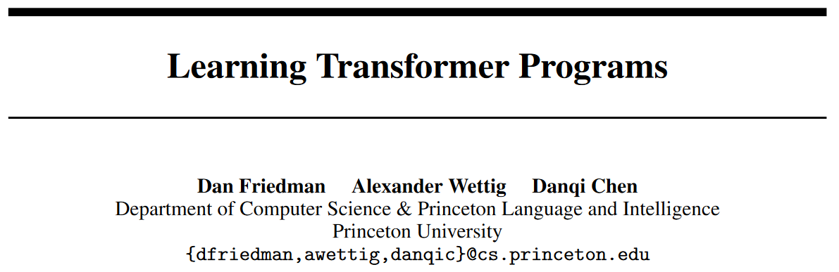
NeurIPS 2023 oral

Slide 2
Abstract - Introduction
Mechanistic interpretability try to reverse-engineer Transformers.
But it need many manual efforts and cannot give complete, faithful descriptions of the underlying algorithms.
We design a modified Transformer that can be trained using gradient, but can automatically converted into a discrete, readable program.
It is mechanistically interpretable by design.
We take inspiration from RASP, a programming language that can be compiled into Transformer weights, but we use it to design Transformer.
These Transformers can be mapped to a program in human-readable language, e.g. Python.

Slide 3
Abstract - Introduction
We learn Transformer Programs on several tasks.
This includes an in-context learning task, a set of algorithmic problems and NLP benchmarks for named entity recognition and text classification.
They can find reasonable solutions, and perform on par with similar-sized standard Transformer.
We can convert these Transformers into Python programs, use code analysis tools to extract the circuits, and even to debug them.

Slide 4
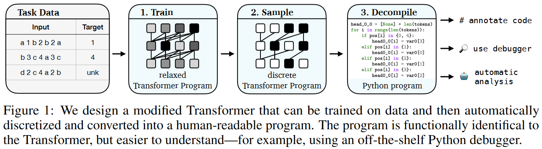
Abstract - Introduction

Slide 5
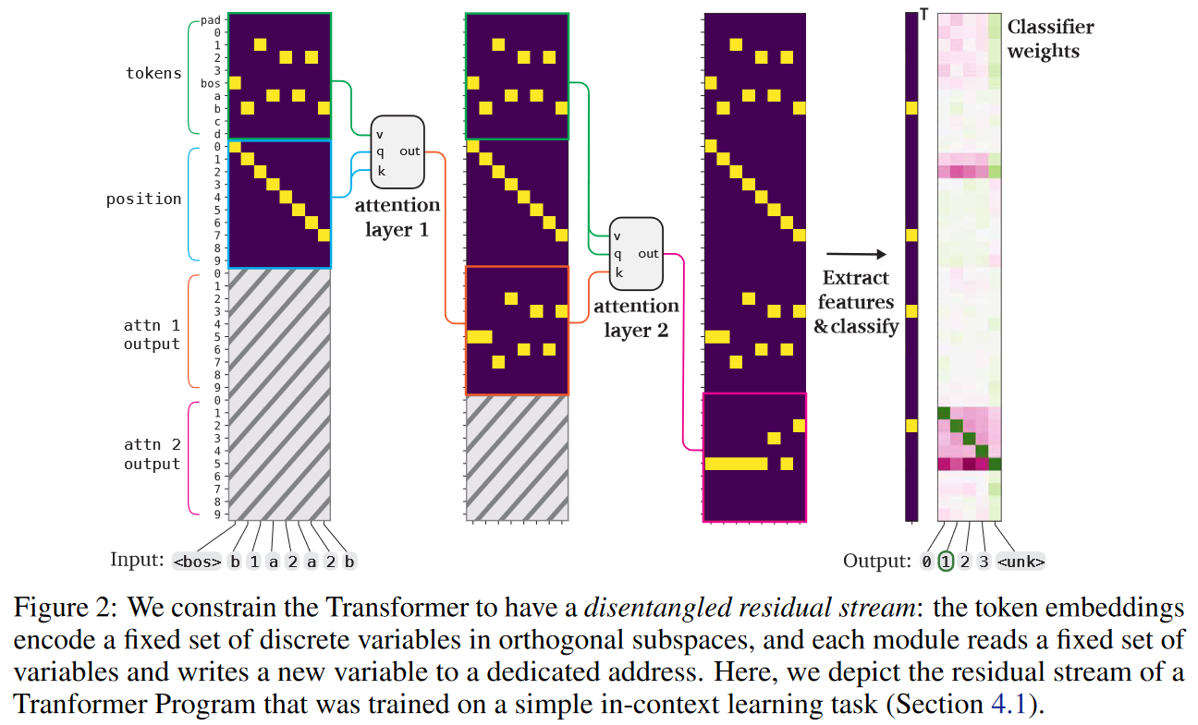
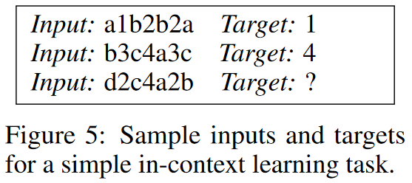
Disentangled Residual Stream

Slide 6
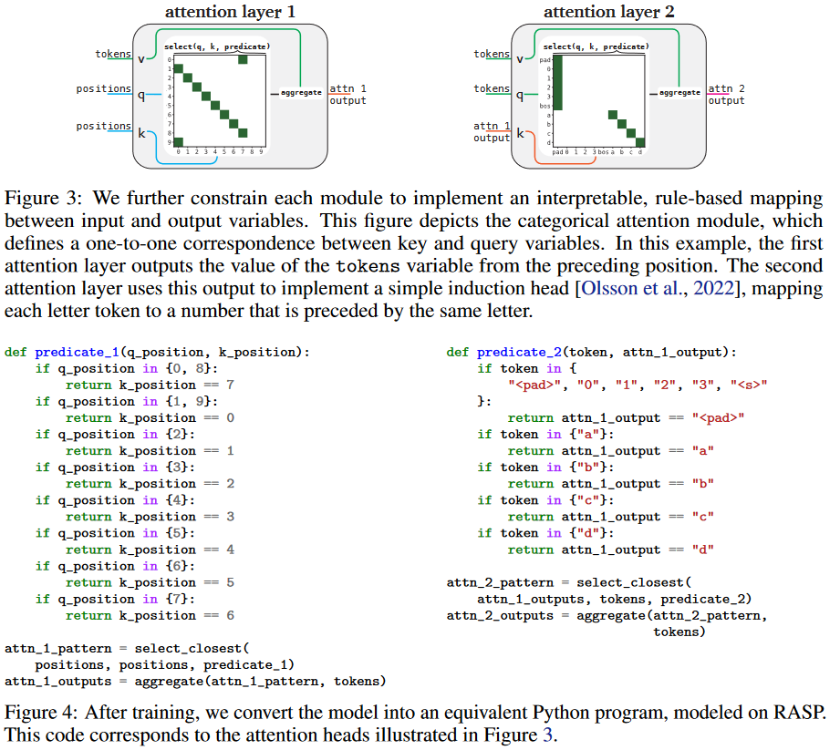
Constraints on Modules

Slide 7
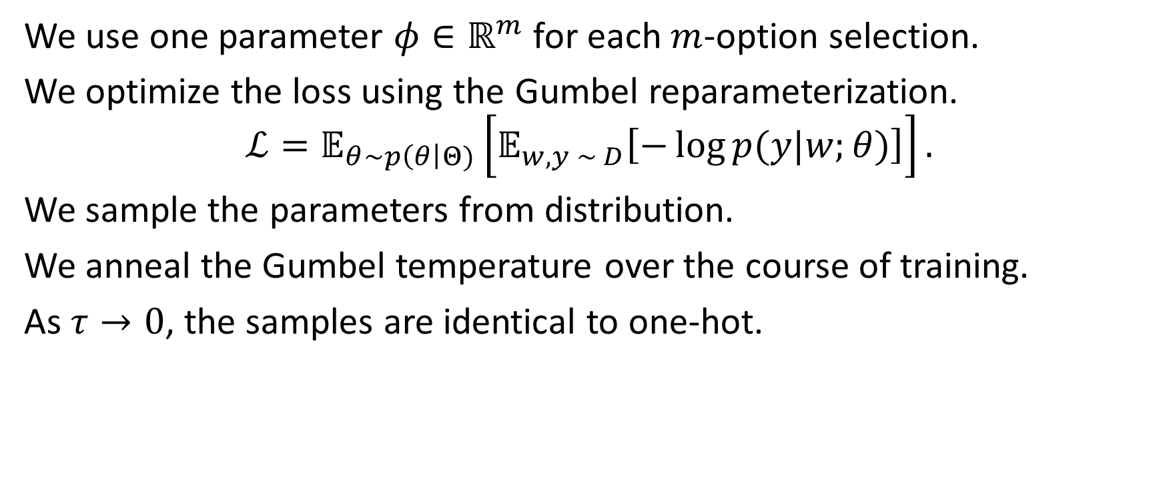
Optimization
We use one parameter $φ∈ℝ^{m}$ for each $m$-option selection.
We optimize the loss using the Gumbel reparameterization.
$$ℒ=𝔼_{θ\sim p\left(θ\right|Θ)}\left[𝔼_{w, y \sim D}\left[−\log{p(y|w;θ)}\right]\right].$$
We sample the parameters from distribution.
We anneal the Gumbel temperature over the course of training.
As $τ→0$, the samples are identical to one-hot.

Slide 8
Extensions
Learning word embeddings.
Use one-hot token embeddings for tasks with a small vocabulary.
Otherwise, each token is represented as a product of several one-hot categories.
Aggregating numerical variables.
Augment the input embeddings with a single scalar variable fixed to 1.
Implement a limited form of numerical attention, which guarantees the output are integers within a bounded range.
Add a new type of head that gives the weighted sum of the values.

Slide 9
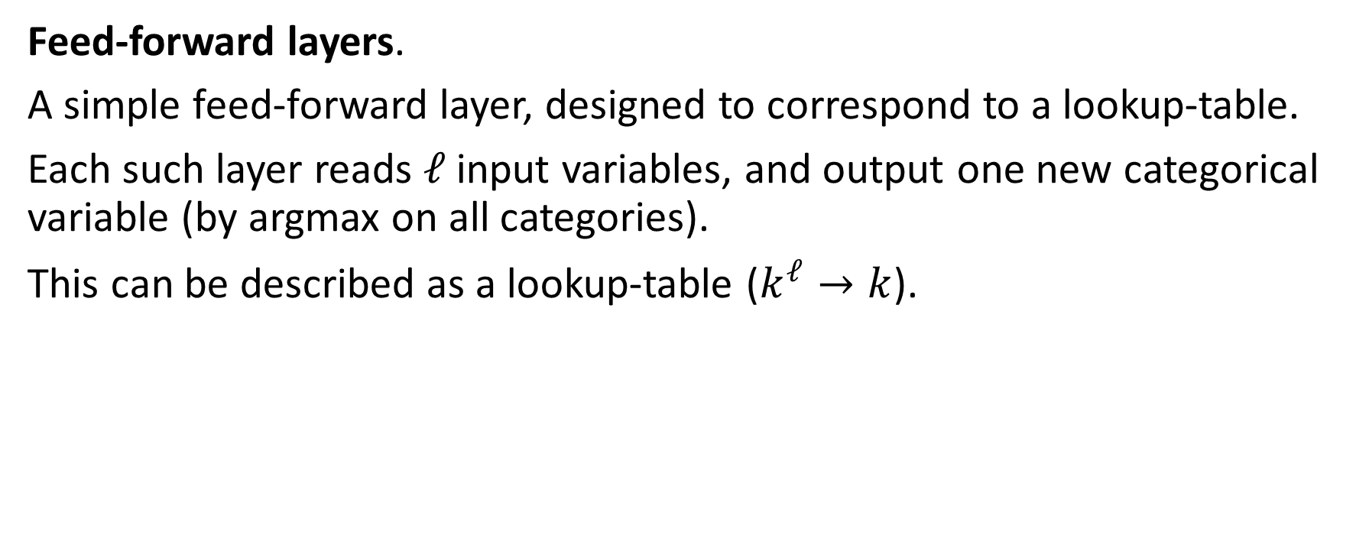
Extensions
Feed-forward layers.
A simple feed-forward layer, designed to correspond to a lookup-table.
Each such layer reads $ℓ$ input variables, and output one new categorical variable (by argmax on all categories).
This can be described as a lookup-table ($k^{ℓ}→k$).

Slide 10
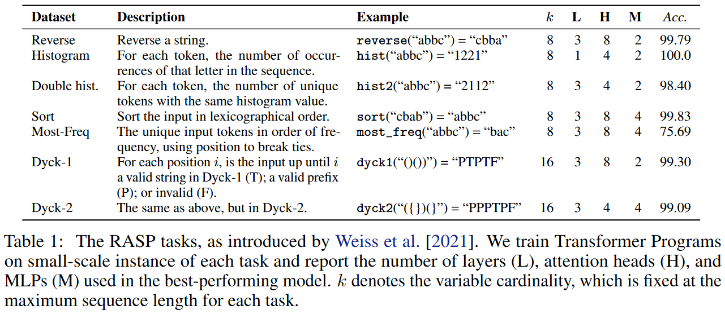
RASP tasks
Notes:
They often degrade on longer inputs. Also, they tend to have more layers and attention heads than we might expect.

Slide 11
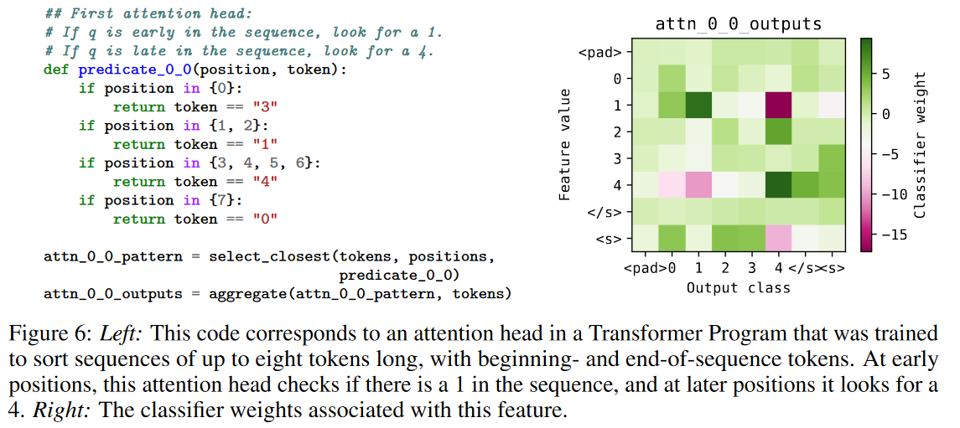
RASP tasks - sorting

Slide 12
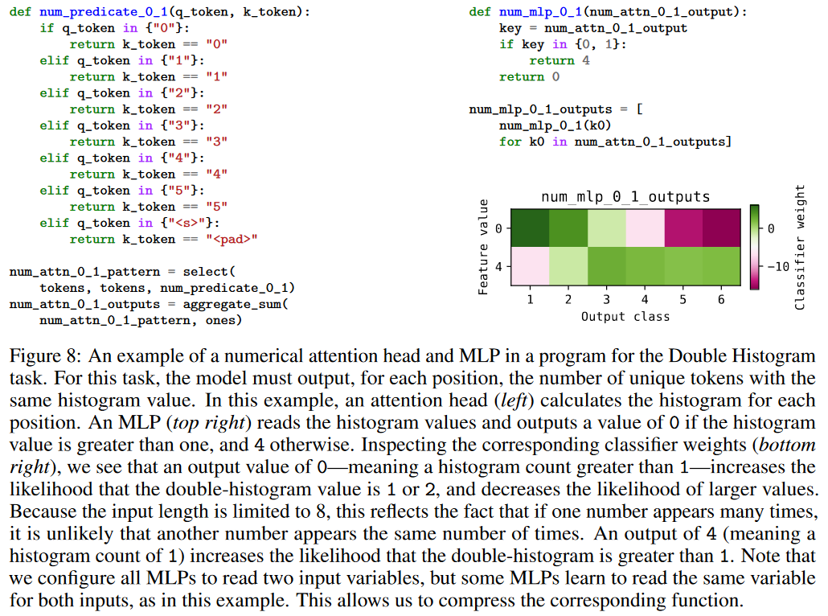
RASP tasks - more examples

Slide 13
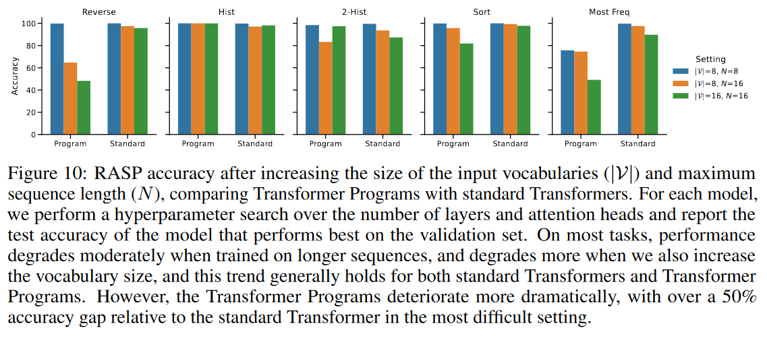
RASP tasks - larger scale versions

Slide 14
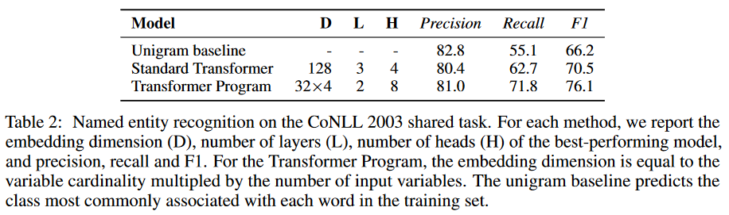
NLP tasks - Results

Slide 15
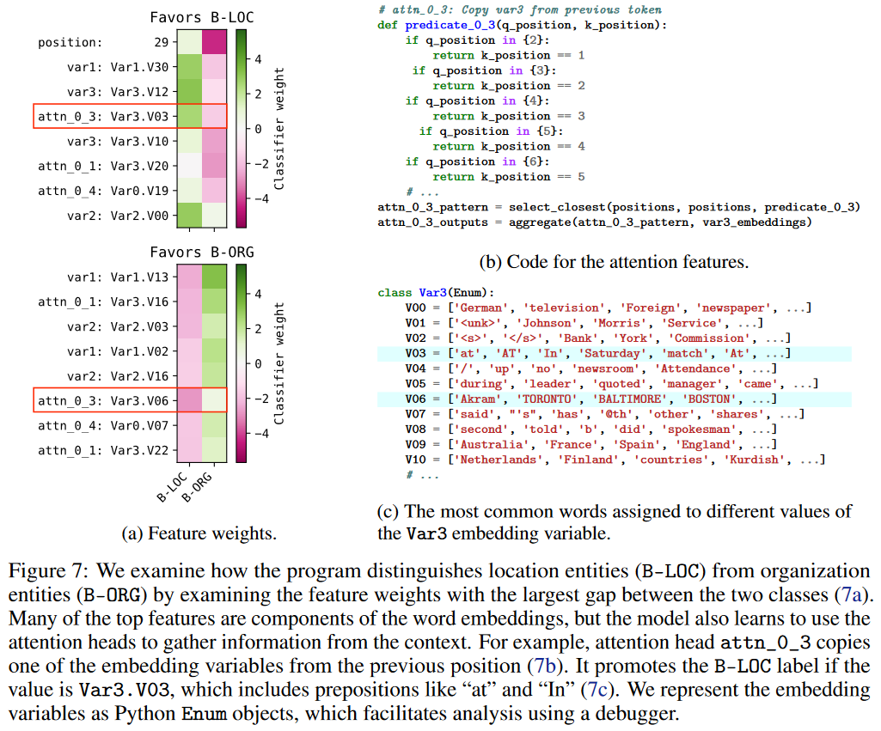
NLP tasks - Interpretability

Slide 16
Conclusion - Discussion
Scaling challenges: they struggle to learn on longer inputs.
We believe it can be fixed by better optimization (since many programs are suboptimal).
Are they interpretable? These programs are sooooo long.
Maybe this can be solved as interpretable feature functions.

